Slide 1
LoxLM

Slide 2
DICOM to BIDS conversion is hard
There exist no fully automatic tools to convert between the two standards
Conversion requires a technician with knowledge of the dataset and the conversion tool

Slide 3
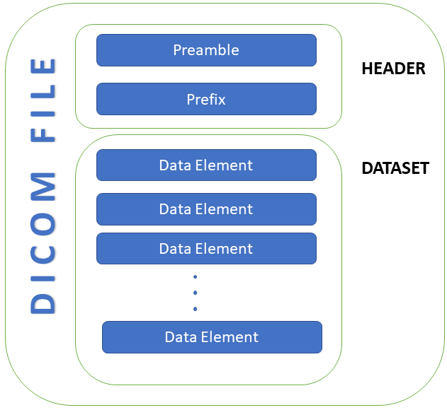
DICOM format
Header information describes the raw data elements.

Slide 4
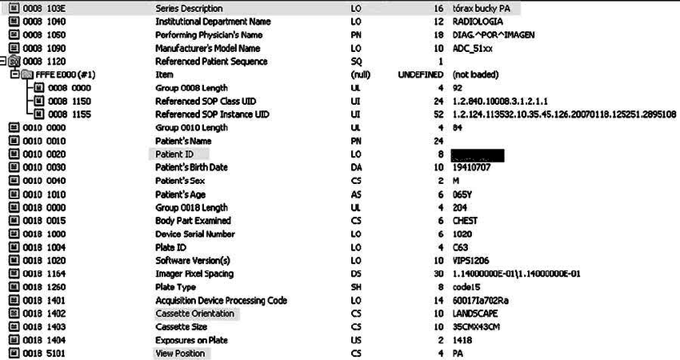
DICOM Headers
Many DICOM tags exist
The values for these tags are frequently entered manually by scanning technician. (INCONSISTENCY)

Slide 5
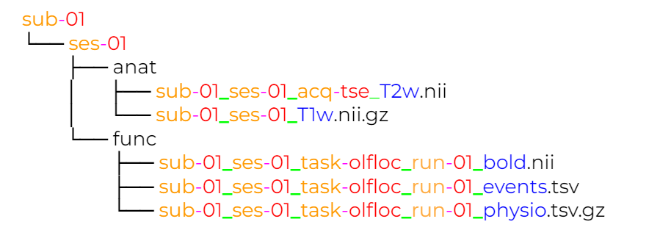
BIDS format
Widely adopted neuroimaging data format
Used for most processing pipelines
Standardized file storage structure and naming scheme
Mapping from DICOM header information to bids naming scheme is non trivial

Slide 6
Existing Approaches
HeudiConv, dcm2bids, bidscoin
There is no existing approach eliminates the need for the researcher to manually create mappings between DICOM and BIDS formats

Slide 7
Our Goal
Create a tool that automatically creates mappings from DICOM data to BIDS file naming
These mappings can be inputted into existing converters to conduct the data conversion

Slide 8
Our Approach
Use Retrieval Augmented Generators an extension of Large Language Models

Slide 9
Large Language Models (LLM)
Extremely trendy, LLMs like ChatGPT, Gemma, and Llama are large neural networks based on the transformer architecture.
They are trained on enormous amount of natural language data.
They take in a “prompt” written and natural language and output a chain of natural language tokens to form a response.

Slide 10
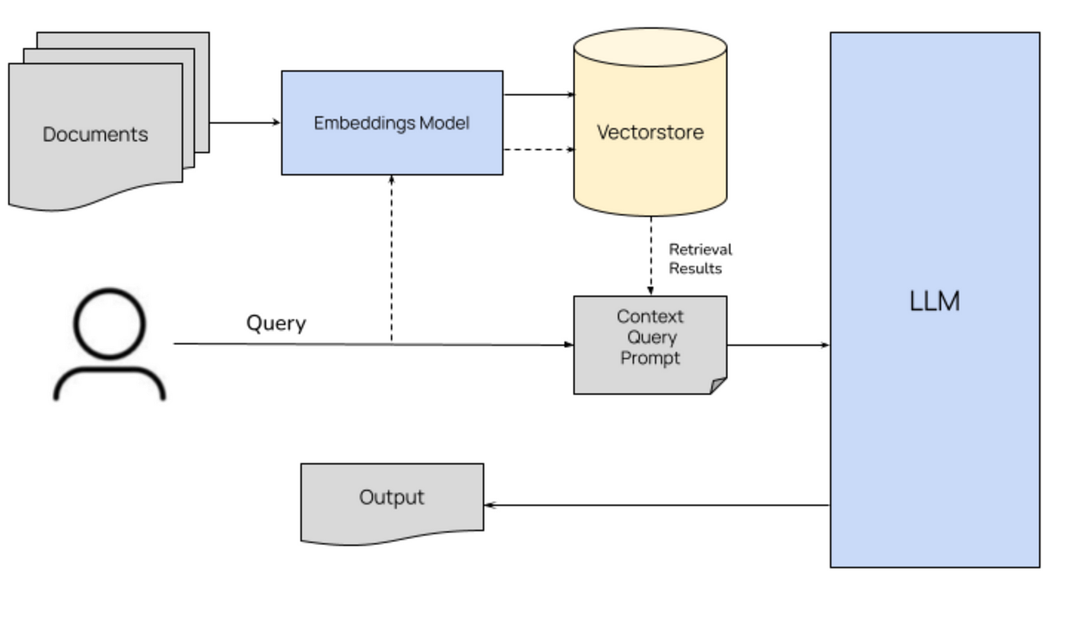
Retrieval Augmented Generation
Problem: LLMs have a tendency to “hallucinate” i.e. output untrue gibberish Solution: Provide “context” to the prompt which ideally provides all of the information the LLM needs to pull from.
https://www.google.com/url?sa=i&url=https%3A%2F%2Fblog.stackademic.com%2Fmastering-retrieval-augmented-generation-rag-architecture-unleash-the-power-of-large-language-a1d2be5f348c&psig=AOvVaw1AkZ1-bpGzEb5lTqaR5W0r&ust=1720800698407000&source=images&cd=vfe&opi=89978449&ved=0CBEQjRxqFwoTCJie0qywn4cDFQAAAAAdAAAAABAE

Slide 11
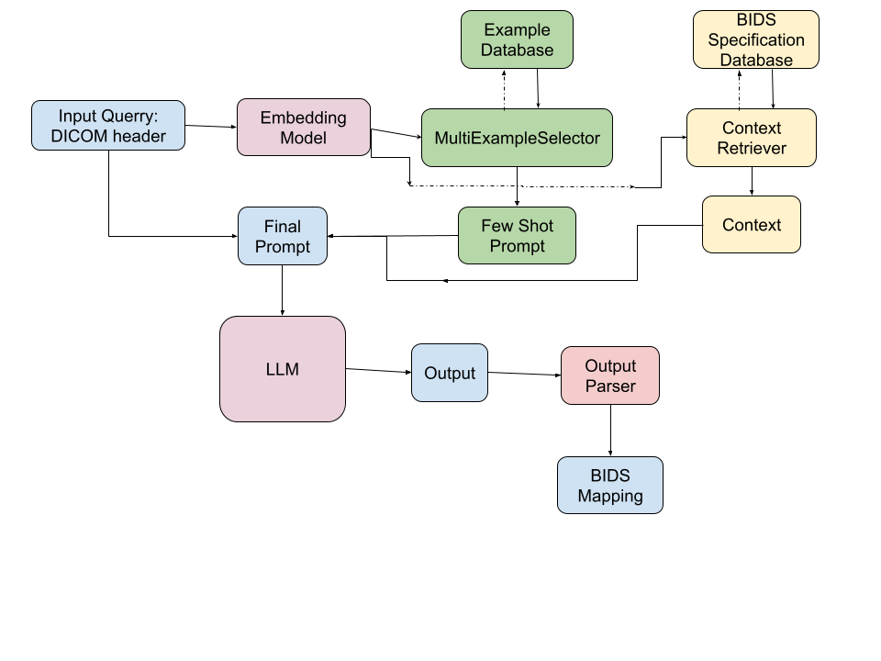
Our Implementation

Slide 12
Input Query
Current Support:
Requires one of SeriesDescription and ProtocolName
Other fields are optional
"SeriesDescription":"t1_mprage_iso0.6_angulated",
"ProtocolName":"t1_mprage_iso0.6_angulated",
"RepetitionTime":3.1,
"EchoTime":0.00252,
"InversionTime":1.5,
"PulseSequenceType":"NA",
"FlipAngle":5,
"Manufacturer":"Siemens",
"ManufacturersModelName":"Investigational_Device_7T"

Slide 13
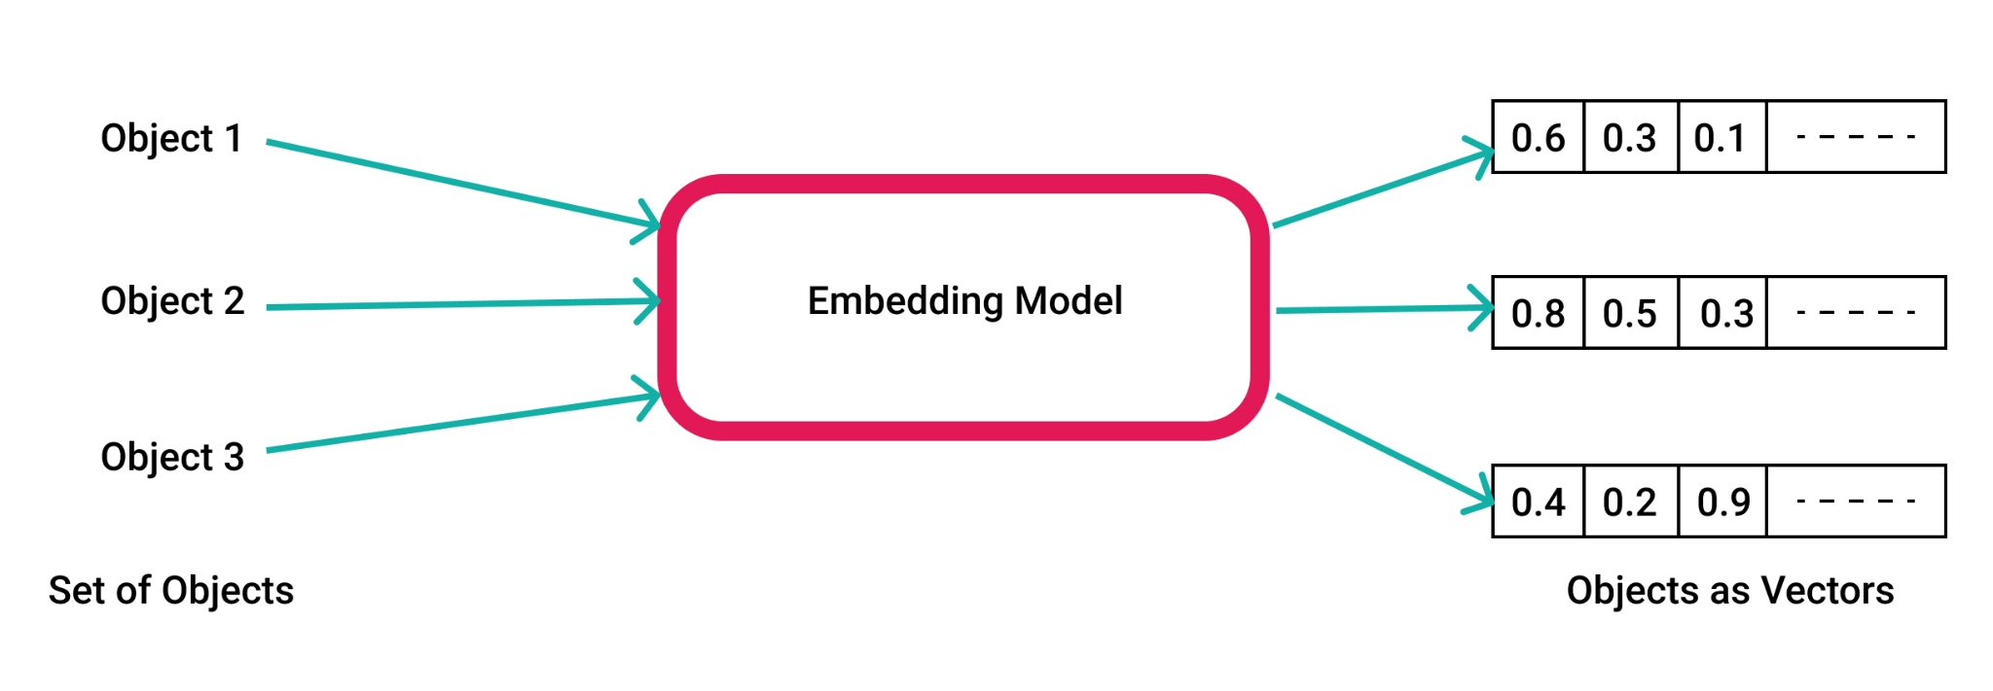
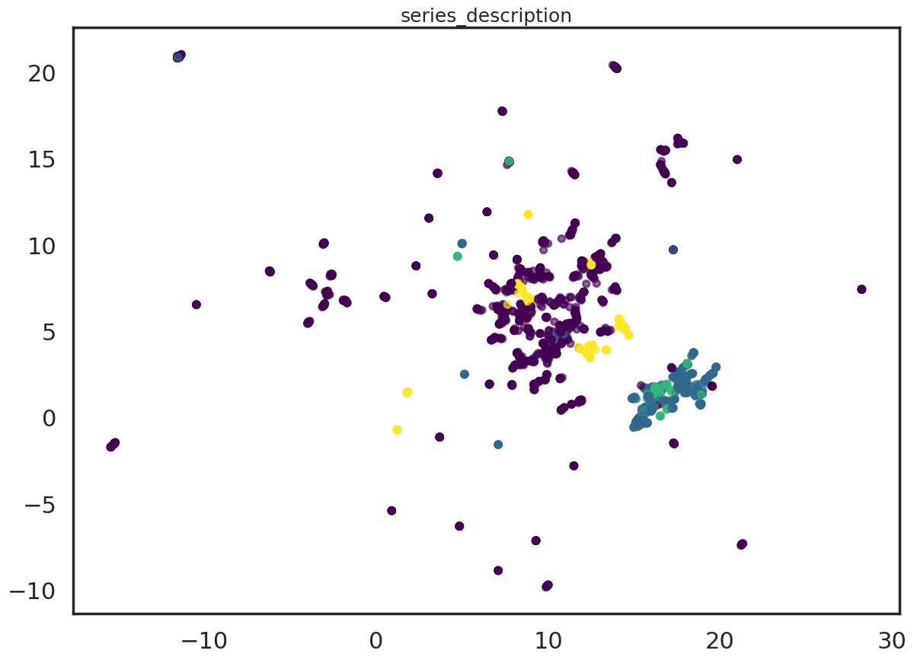
Embedding Model
Projects strings into vector space
Ideally conserves semantic relationships
It an be difficult to get meaningful embeddings with some DICOM entries
Some embedding models perform better than others
Expanding Series Descriptions improved performance
OpenAI : text-embedding-3-small

Slide 14
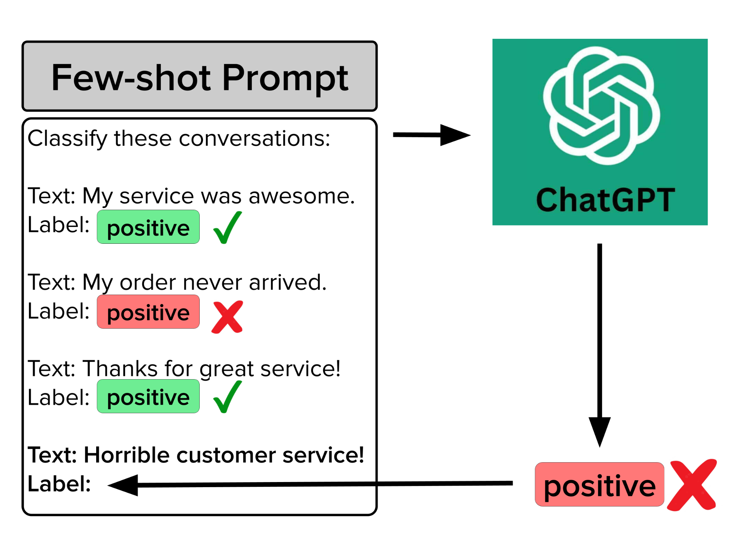
Example Prompting: Few Shot Prompts
To assist the LLM, examples are added to the prompt using a FewShotPrompt.
Examples demonstrate to the model how it should respond by giving some correct question and answer responses relevant to the input query.
https://www.google.com/url?sa=i&url=https%3A%2F%2Fcleanlab.ai%2Fblog%2Freliable-fewshot-prompts%2F&psig=AOvVaw3japMRCS7Oz3y10erUk20x&ust=1720803699373000&source=images&cd=vfe&opi=89978449&ved=0CBEQjRxqFwoTCKC_vry7n4cDFQAAAAAdAAAAABAE

Slide 15
Examples
Examples are constructed in the same way as input queries.
With the addition of the BIDS suffix.
Internally they are stored as pydantic BaseModels
Examples are composed of DICOM header information.
Some fields are strings and some are floats
"index":"T1w", "SeriesDescription":"GIfMI_T1_MPRAGE",
"ProtocolName":"NA",
"RepetitionTime":2.25,
"EchoTime":0.00418,
"InversionTime":0.9,
"PulseSequenceType":"NA",
"FlipAngle":9,
"Manufacturer":"SIEMENS",
"ManufacturersModelName":"NA"

Slide 16
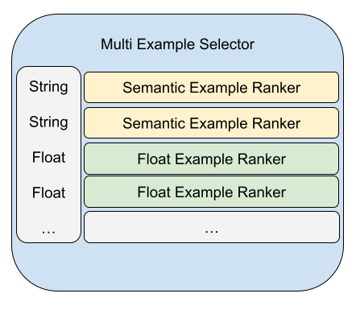
Multi Example Selector
Problem: Find k most similar Examples in database to the input query.
Individual fields in the example are treated separately
Comprised of:
SemanticExampleRanker: for strings
FloatExampleRanker: for floats
Future Extension:
Group some float fields together because they are not independent

Slide 17
Semantic Example Ranker
String fields are embedded into vector space
Distance between embedded query string and examples in database is calculated using cosine similarity.
Distances are normalized [0,1]
Some examples in database may be missing a field. This distance in this case is returned np.nan

Slide 18
Float Example Ranker
Distances between query float value and example database floats are calculated as the absolute value of the difference
Distances are normalized between [0,1]
Missing values return np.nan

Slide 19
Putting it all together
The distance between each example in the database is calculated with the input query.
This is done for each field of the input example
The resulting distance matrix shape (# of examples, #of fields in query)
This is scaled by weight matrix W (1, # fields examples) with values ∊ [0,1]
The scaled distance matrix is summed yielding vector of shape (# examples, 1)
This is divide by a vector that corresponds to the number of non nan values in each column of the distance matrix
The k examples with the lowest distance are returned.

Slide 20
Context Retriever
The context retriever selects documents parsed from the BIDS specification.
These documents are stored in a vector database
They are selected based off semantic similarity score between an embedded input query.

Slide 21
Final Prompt: many parts
System Prompt:
Instructs the LLM in what it is and how its response should be formatted. Format instructions are derived from pydantic BaseModel that Examples are stored as.
Few Shot Prompt:
Example responses
Context:
Retrieved BIDS context
Input Query:
Finally the inputted DICOM query

Slide 22
LLMs
Using Ollama it is very easy to run models locally (if you have the compute necessary)
Popular models like Llama 3 and Gemma have distinct personalities
Output formats can be inconsistent
OpenAI models
With API key very easy to execute
GPT3-turbo similar performance, with more consistent and coachable formatting
GPT4o is WAY better than all other models I tested

Slide 23
Output Parser
LLM outputs can be variable and frustrating to deal with
Langchain provides some output parsers that expect JSON or pydantic output
These are often unreliable

Slide 24
Results and Difficulties
Initial results were very promising.
It is hard to wrangle LLMs to be consistent.
Its like trying to get a child to complete a task. Often it works well, but sometimes they misbehave very unpredictably
GPT4o saved this project.
Achieves ~97% correct classification on test set of ~1450 examples
It is possible this would be higher in practice, because some examples are very poor

Slide 25
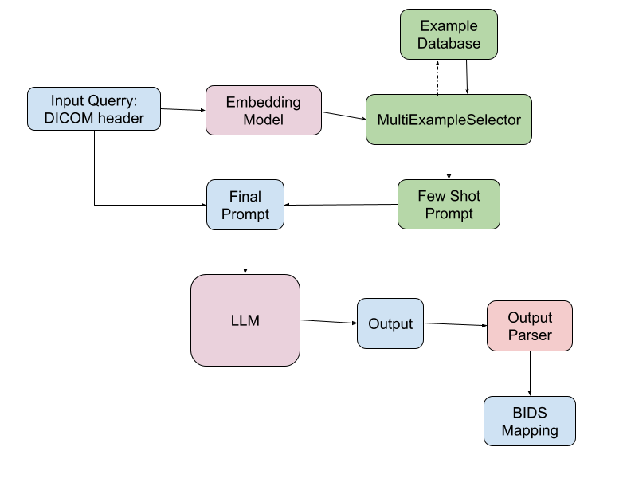
Final Architecture

Slide 26
Areas for improvement
Expand testing
So far I have only tested the performance on datasets extracted from openneuro
It would be good to test on large datasets like ppmi, etc.
It would be difficult to test accuracy on these datasets that have not been converted to bids already
Develop integration with conversion tools
Currently LoxLM can ingest dicom files and output json files associating the corresponding bids suffix with the file
This tool would be more useful if it is integrated in the pipeline of other tools such as nipoppy

Slide 27
Thoughts about LLM development tools
Ollama
Convenient for rapid prototyping, free, and containerizable
Open source models are not as performanent as proprietary models
LangChain
Easy to get started, many integrations with other software e.g. vector stores, etc.
Many of their implementations seem underdeveloped, documentation is a little all over the place
It is possible to write custom classes for most things
Milvus
Pretty straightforward vector database, runs in docker, integrated with LangChain
Some periodic issues where I have to completely remove and recreate the database

